Slide 1

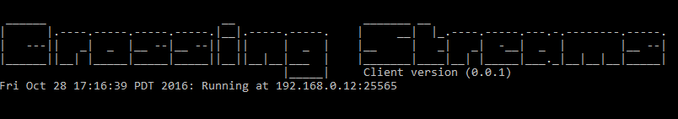
Sprint 3 (Nov 16 - Nov 30) Project Report
Project: Crossing Streams
Ben Ward Marc-Andrew Dunwell
Corey Frank Dan Atkinson Billy Spelchan
Okanagan College, Kelowna, BC
Nov 30th, 2016

Slide 2
Report Content
Project Summary
Sprint 3 (November 16 - November 30, 2016) Project Report
Demo
Conclusion
Notes:
Project Summary
Sprint 1 (October 20 - November 1, 2016) Project Report
Demo
Conclusion

Slide 3
Project Summary
Crossing Streams is a two-phase project conducted by students of Okanagan College and their client Ben Heggie. The first phase began in 2016 as a project for COSC 470. It’s main results are:
The design and implementation of an Multiplayer Online Rogue-like Top-Down Shooter (MORTDS) done in the style of Binding of Isaac, Enter the Gungeon and Gauntlet.
An integrated web platform that includes payment and hosting abilities for multiple future games.
A low latency environment to allow for smooth online gameplay with friends
Notes:
Crossing Streams is a two-phase project conducted by students of Okanagan College and their client Ben Heggie. The first phase began in 2016 as a project for COSC 470. It’s main results are:
The design and implementation of an Multiplayer Online Rogue-like Top-Down Shooter (MORTDS) done in the style of Binding of Isaac, Enter the Gungeon and Gauntlet.
An integrated web platform that includes payment and hosting abilities for multiple future games.
A low latency environment to allow for smooth online gameplay with friends

Slide 4
Project Goals
Infrastructure to play games Online
This project utilizes infrastructure created entirely from students.
It should allow 2-4 players to play together online
By using golang we can innovatively spin up new processes on a server to encase a user's game.
Unity allows the developers to not worry about the boilerplate and go right to developing the features.
Notes:
Infrastructure to play games Online
This project utilizes infrastructure created entirely from students.
It should allow 2-4 players to play together online
By using golang we can innovatively spin up new processes on a server to encase a user's game.
Unity allows the developers to not worry about the boilerplate and go right to developing the features.

Slide 5
Theme - The Finale
The focus of the 3rd sprint was to get the basic happy path completed from start to finish. Implementing everything from the website to the multiplayer focus. The multiplayer while there in sprint 2 was far from complete and needed the additional functionality of multiple lobbies and support for 4 players. In addition, we endeavor to make the world compelling for multiple players and are continuing to more add power ups, more monsters, and more rooms.
Notes:
Joining the streams. The system we are developing is made up of a number of interconnected components so we wish to get all the components working at the most basic level possible. The client will be able to download the patcher from the game site, update to the current (first) build of the game, and run through a very simplified version of the game with just rudimentary server connections.

Slide 6
Happy Path
(Shiny new)

Slide 7
System Architecture Layout (old)

Slide 8
System
Architecture
Layout
(Same Old
thang)

Slide 9
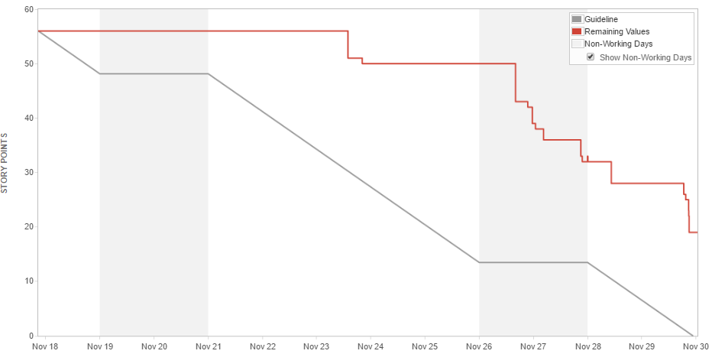
Burndown and workload (In Story points)
Notes:
Burndown chart shows a stagnant workflow and a rush at the very end. Many of us had other commitments to classes, exams and projects which relates to the beginning stagnant workflow as well many of the tasks could have been further broken down into smaller pieces.

Slide 10
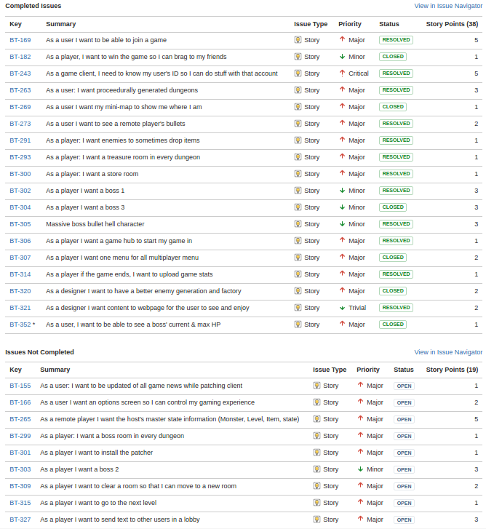
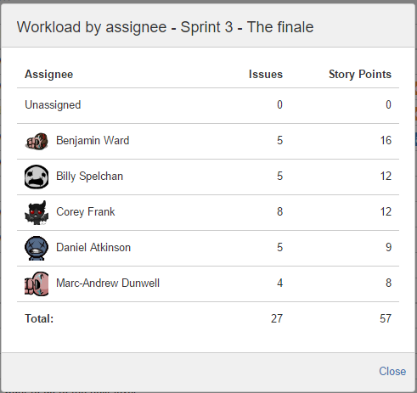
Sprint Backlog
Notes:
There was a total of 26 user stories with 54 points. The story points were mostly distributed evenly across all five team members.

Slide 11
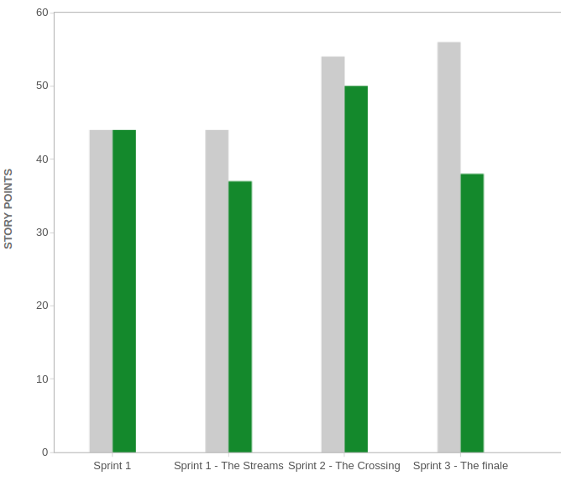

Velocity so far
Committed: 57
Completed: 38
Notes:
We committed to a lot of work and we were able to finish the mass majority of it. The tasks which were unfortunatly not finished were of lower value to the project as an overall. The overall feel is that we bit off too much this sprint and will lower our work load to the levels of sprint 1 for this upcoming sprint 3.

Slide 12
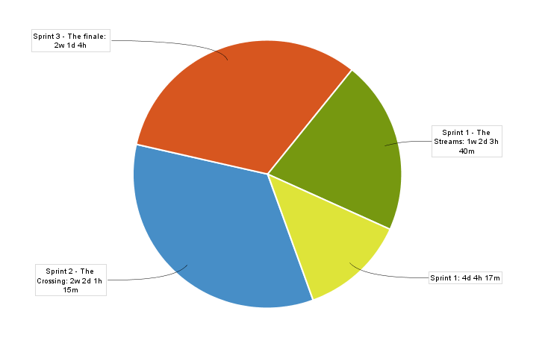
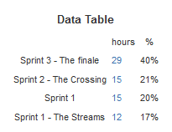

Time Spent / Sprint Breakdown

Slide 13
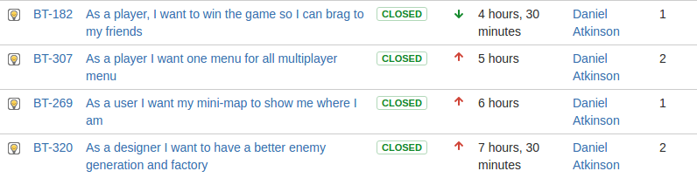
Sprint 3 (Daniel Atkinson)

Slide 14
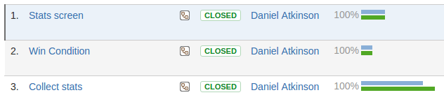
Task breakdown (Daniel Atkinson)

Slide 15
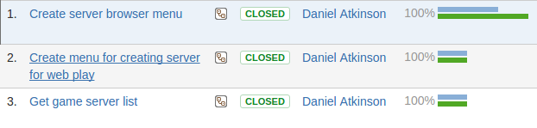
Task breakdown (Daniel Atkinson)

Slide 16
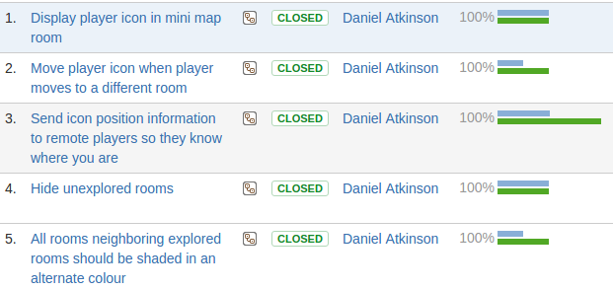
Task breakdown (Daniel Atkinson)

Slide 17
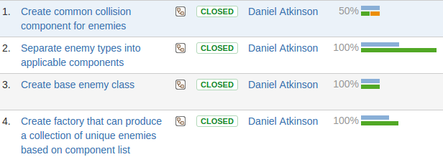
Task breakdown (Daniel Atkinson)

Slide 18
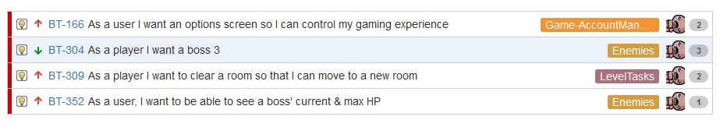
Sprint 3 (Marc-Andrew Dunwell)

Slide 19
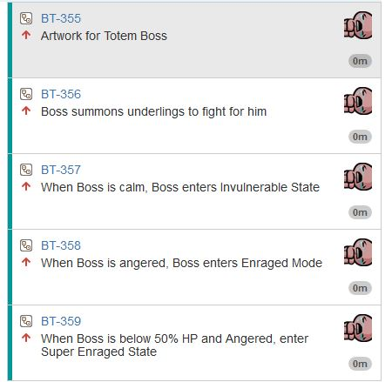
BT-304 - Task breakdown
BT-304: As a user I want Boss #3

Slide 20
Boss Sequence Diagram

Slide 21
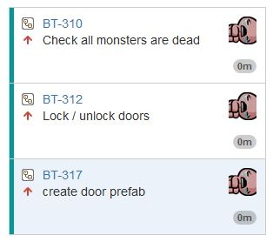
BT-309- Task breakdown
BT-309: As a player, I want to clear a room, so that I can move to a new room

Slide 22
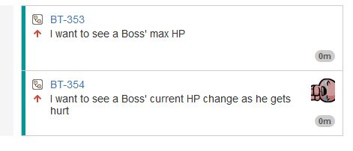
BT-352- Task breakdown
BT-352: As a player, I want to see a Boss’ current & max HP

Slide 23
Boss Health Sequence Diagram

Slide 24
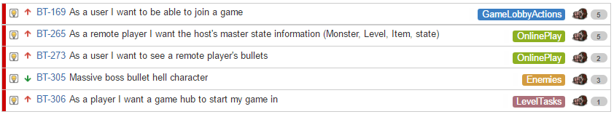
Sprint 3 (Ben Ward)
Notes:
Server Installation:
Acquired servers from Youry
Installed developer tools (apache, postgresql, golang, php, webmin)
Golang Server Application:
Can connect to the postgresql database to obtain information
Can Receive and send seed information to clients
Database:
Created database, schema, relational tables

Slide 25
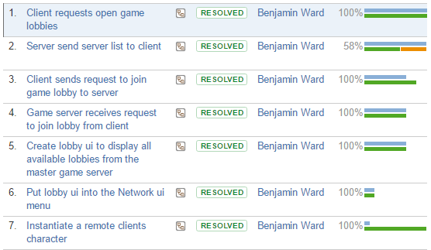

Join A Game - Task breakdown (Ben Ward)
AGAIN!!
Notes:
Installed Jenkins, github plugin, configured it to poll our repos and it runs a script that tests, builds and deploys from our master repo.

Slide 26

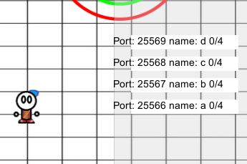
Multiple lobbies!
Almost as nice as this lobby

Slide 27

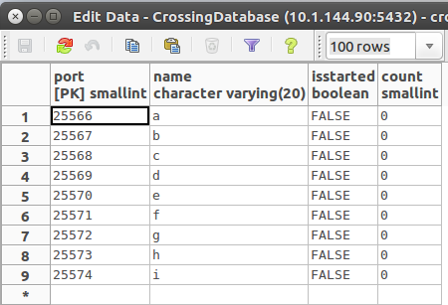


Where to store the lobby info?
Server
Database
Client

Slide 28
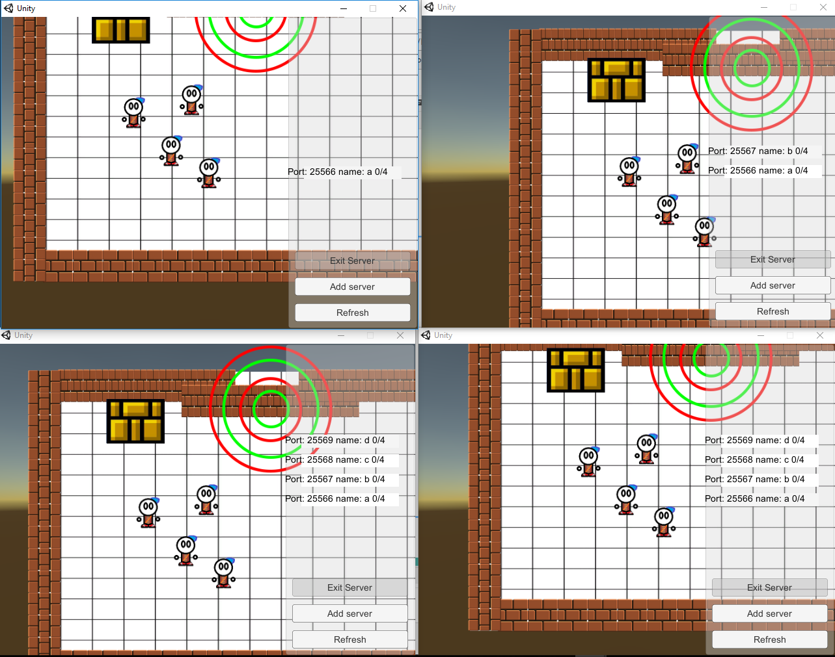


Instantiate players
HOST
CLIENT
Now you can play with
all your assho..
I mean great friends!
CLIENT
CLIENT

Slide 29
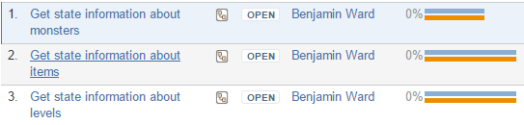

Host Master State- Task breakdown (Ben Ward)
( Incomplete :( )

Slide 30
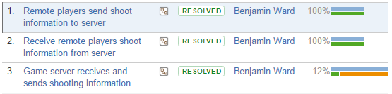
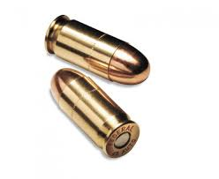
Remote Bullets - Task breakdown (Ben Ward)

Slide 31
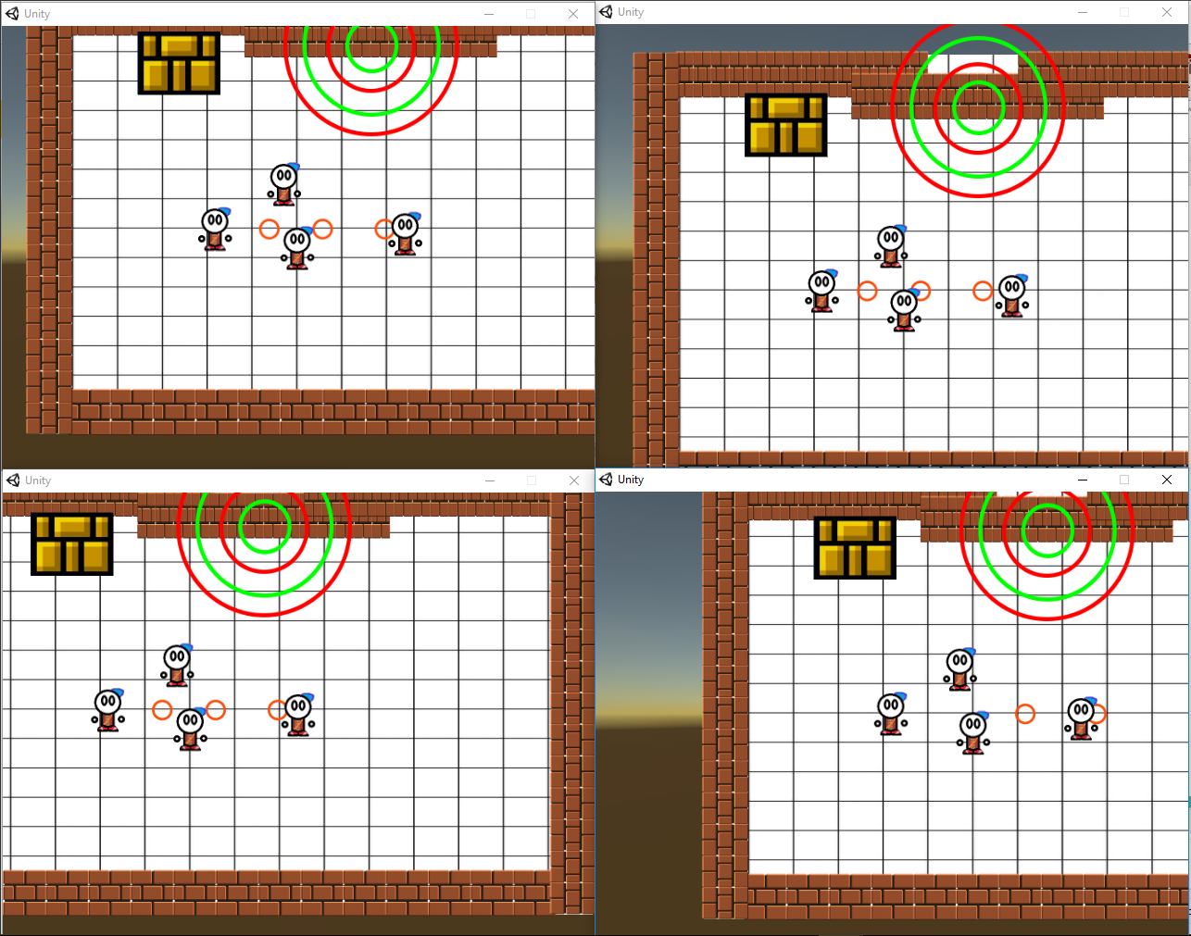

I Shoot!!
You Shoot!

Slide 32
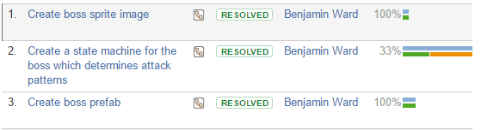
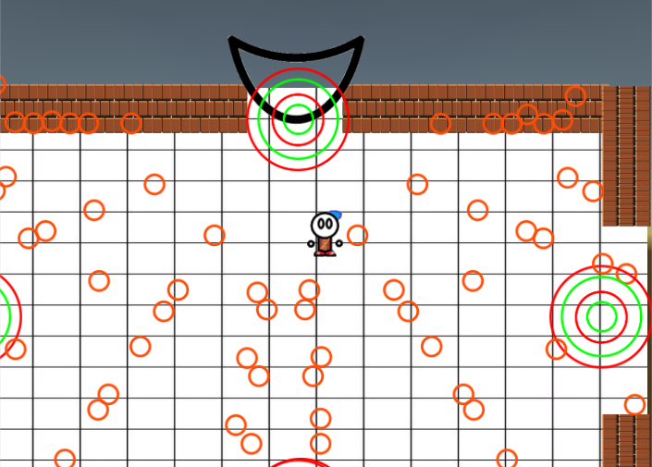
Bullet Hell Boss - Task breakdown (Ben Ward)
Not so Massive...

Slide 33
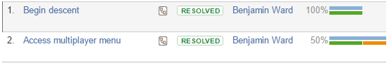
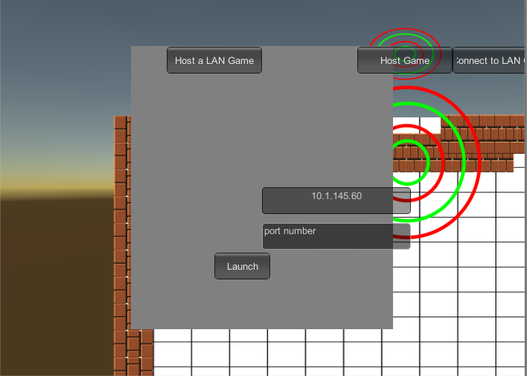
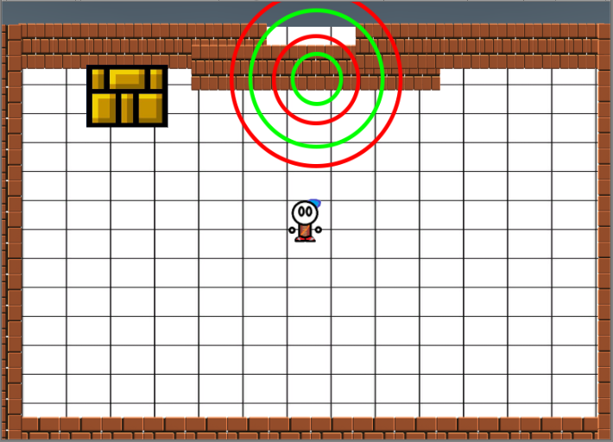
Start Hub - Task breakdown (Ben Ward)
Touching this
Does this

Slide 34
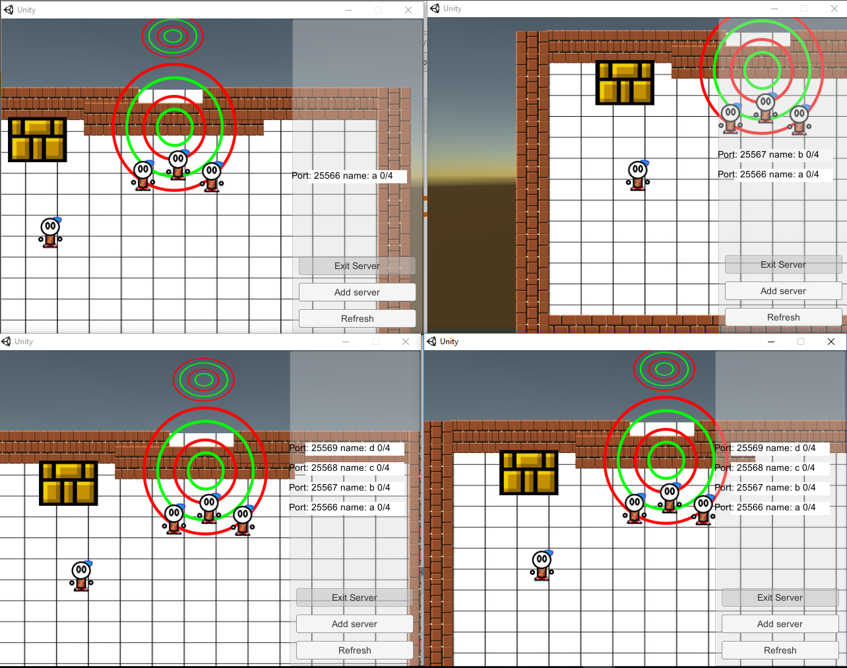
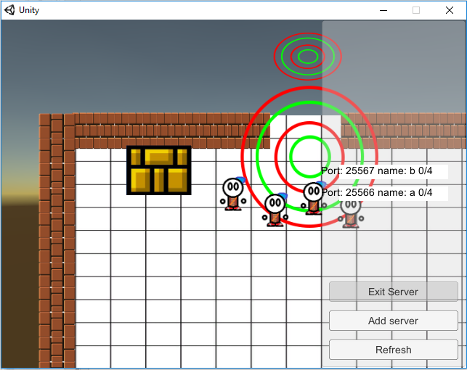
Start Hub (Continued)
When everyone is on the trigger
Open Sesame!

Slide 35
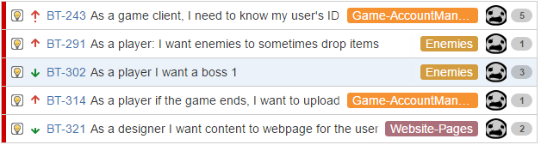
Sprint 3 (Billy Spelchan)

Slide 36
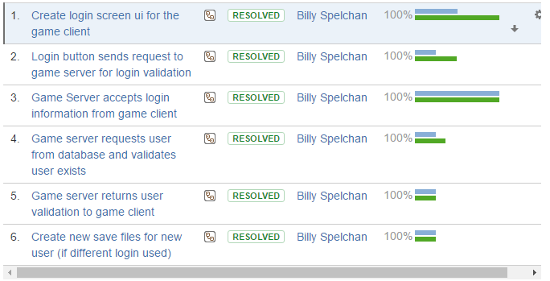
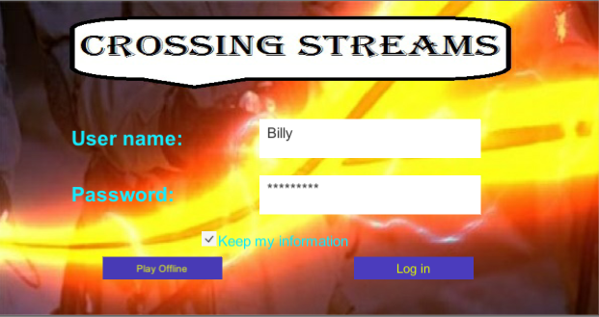
BT-243 Game Site Login (Billy Spelchan)

Slide 38
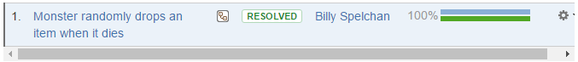
BT-291 Enemy drops (Billy Spelchan)

Slide 39
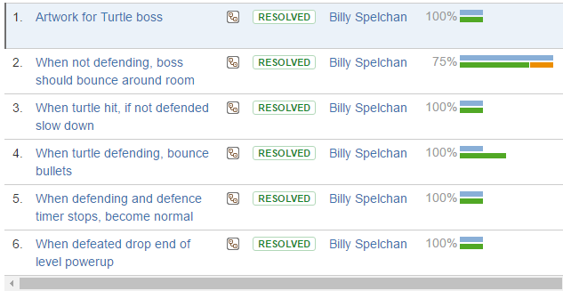
BT-302 Turtle Boss (Billy Spelchan)

Slide 41
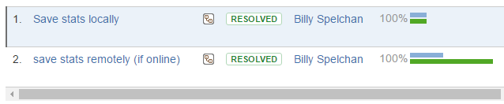
BT-314 Upload stats (Billy Spelchan)

Slide 42
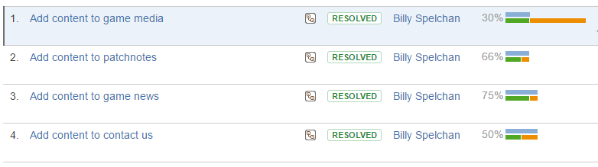
BT-321 Website content (Billy Spelchan)

Slide 43
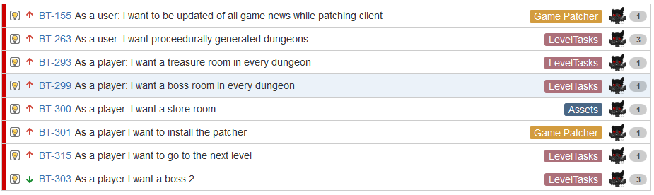
Sprint 3 (Corey Frank)

Slide 44
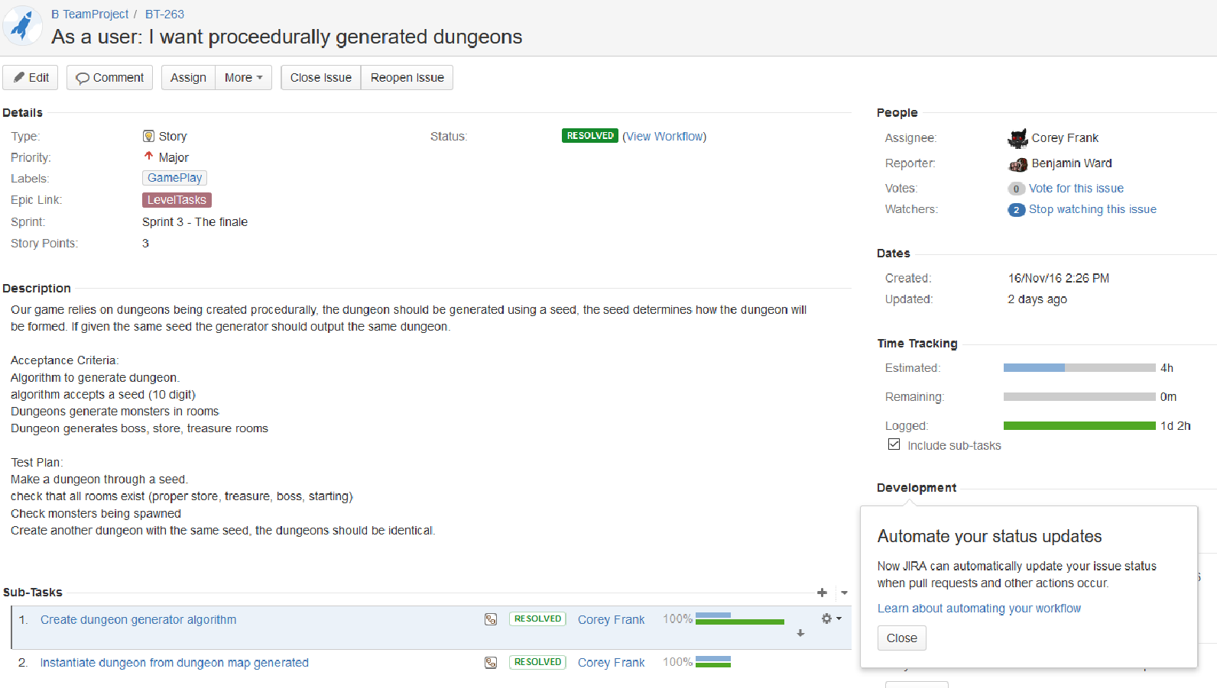
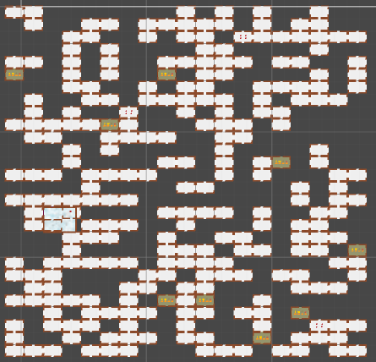
Task breakdown (Corey Frank)

Slide 45
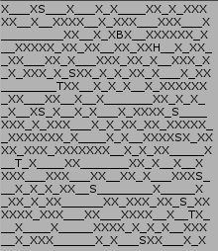
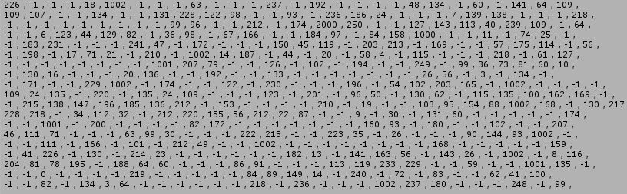
Task breakdown (Corey Frank)

Slide 46
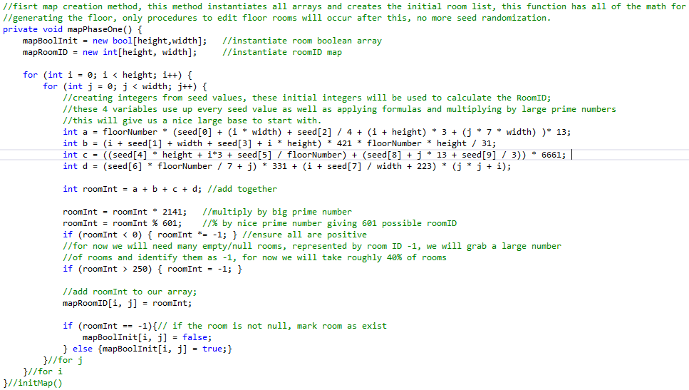

Slide 47
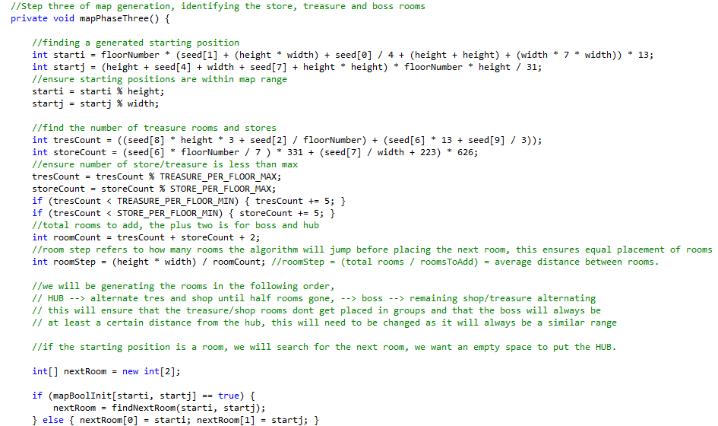

Slide 48
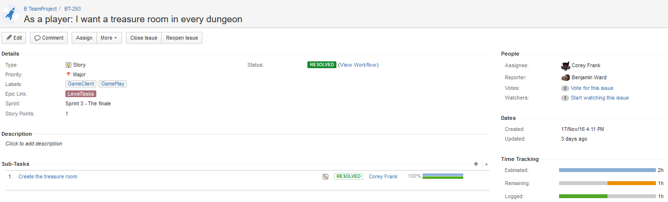
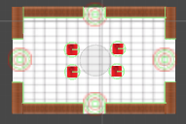
Task breakdown (Corey Frank)

Slide 49
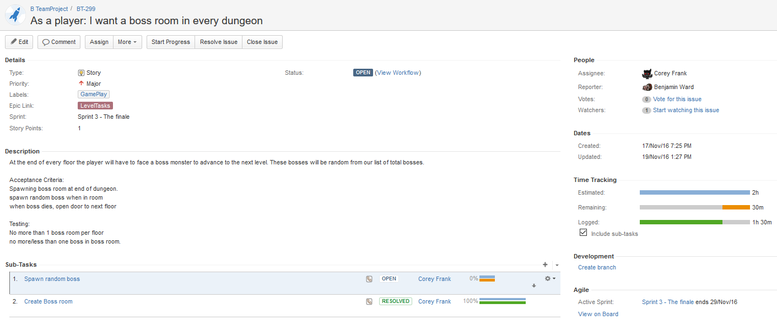
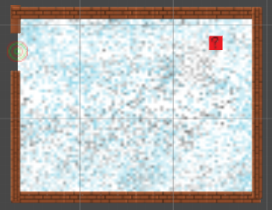
Task breakdown (Corey Frank)

Slide 50


Task breakdown (Corey Frank)

Slide 51


Task breakdown (Corey Frank)
An added task that was not outlined in the Sprint planning. Adding in mini-map room representations. For this task i needed to create mini-map rooms that will be used in the instantiation of the mini-map, that will distinguish the rooms apart

Slide 52

Task breakdown (Corey Frank) - Incomplete Stories

Slide 53

Task breakdown (Corey Frank) - Incomplete Stories

Slide 54

Task breakdown (Corey Frank) - Incomplete Stories

Slide 55

Task breakdown (Corey Frank) - Incomplete Stories

Slide 56

Demonstration
Let’s Play - Part Three
Sprint 3 - Can I sleep now?
Notes:
Server IP 10.1.144.91:25565

Slide 57
Any Questions?

